Slide 1
Evaluating User Experience Session #02
Course : GAME6012/ User Experiences
Effective Period : September 2017

Slide 2
These slides have been adapted from: Julie A. Kientz (2014). User Experience Design, University of Washington.
Acknowledgement

Slide 3
Evaluating UX (Roto et al.)
Understand what good UX actually means
Define metrics for UX
Define the methods for evaluating UX (against the metrics)
Integrate UX evaluation into the product development process

Slide 4
Overview
Models of UX
HEART framework
Kano
Technology Acceptance Model
Metrics
NASA TLX, PULSE, User Burden
Biometrics
Heart rate, breathing, GSR, EMG, eye movement

Slide 5

HEART framework (Google UX)
Happiness
Engagement
Adoption
Retention
Task Success

Slide 6

Happiness
Subjective aspects of UX
Satisfaction, visual appeal, likelihood to recommend, perceived ease of use
Measured via survey with 7 point Likert scale

Slide 7
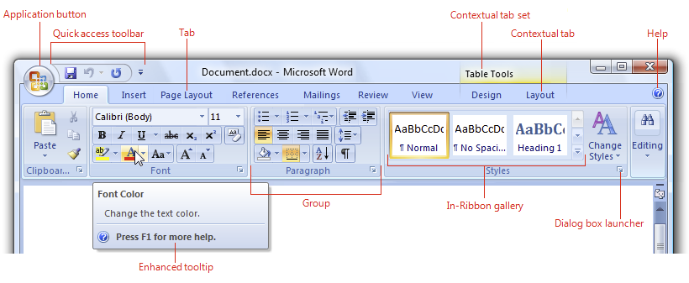
Change Aversion
Users are often adverse to changes, even if they improve the system
Happiness metrics can dip if you roll out a new change, but may show improvement as users adapt
Microsoft Office
“Ribbon”

Slide 8
Engagement
User’s level of involvement with a product
behavioral proxies like frequency, intensity, or depth of interaction over time
Measured via visits per user per week, number of photos uploaded per day, etc.
Report average per user rather than total count

Slide 9
Adoption & Retention
Adoption: measures of number of new users start using a product over a given time period
Retention: how many existing users are still present in some later time period
Success may depend on accomplishing tasks, like registering for new account

Slide 10
Task Success
Includes more traditional usability metrics, such as:
efficiency (time to complete a task)
effectiveness (percent of tasks completed)
error rate

Slide 11
Assignment
Use Heart Model to evaluate your model

Slide 12
References
Buxton, William. 2007. Sketching user experience. Elsevier
Anderson, Stephen. 2011. Seductive Interaction Design. New Riders.
Faranello, Scott. 2016. Practical UX Design. Packt Publishing

